Slide 1

BREAST CANCER MACHINE LEARNING CAPSTONE PROJECT PRESENTATION
UTPAL MISHRA

Slide 2
01
INTRODUCTION
02
MODELING
CONTENTS
03
EVALUATION METRICS
RESULTS and CONCLUSION
04

Slide 3

INTRODUCTION
Breast cancer starts its activity in the breast cells of both men and women. Globally, it ranked as the second most common type of cancer after lung cancer and the fifth most common cause of death due to cancer. The National Breast Cancer Foundation has valued around 2,00,000 new breast cancer cases and 40,000 deaths annually in women. In men, these stats are 1700 and 450, correspondingly.
Breast cancer is highly major in today’s world. According to the National Cancer Institute, an estimated 2,07,090 new cases and 39,840 deaths from breast cancer in only women, are predicted to occur despite the recent breakthroughs in treatment. Given such conditions, early diagnosis of breast cancer is considered vivacious because statistics show a five-year survival rate of 96% for those who were diagnosed with cancer at early stages.

Slide 4

PROBLEM STATEMENT
To build an efficient Machine Learning Classification model in order to analyse and detect Breast Cancer on the basis of lump dimensions and distribution available from the WDBC Data.

Slide 5

DATASET
Attribute Information about Breast Cancer Wisconsin (Diagnostic) Data Set:
1) ID number
2) Diagnosis (M = malignant, B = benign)
3-32)
Ten real-valued features are computed for each cell nucleus:
a) radius (mean of distances from center to points on the perimeter)
b) texture (standard deviation of gray-scale values)
c) perimeter
d) area
e) smoothness (local variation in radius lengths)
f) compactness (perimeter^2 / area - 1.0)
g) concavity (severity of concave portions of the contour)
h) concave points (number of concave portions of the contour)
i) symmetry
j) fractal dimension ("coastline approximation" - 1)

Slide 6
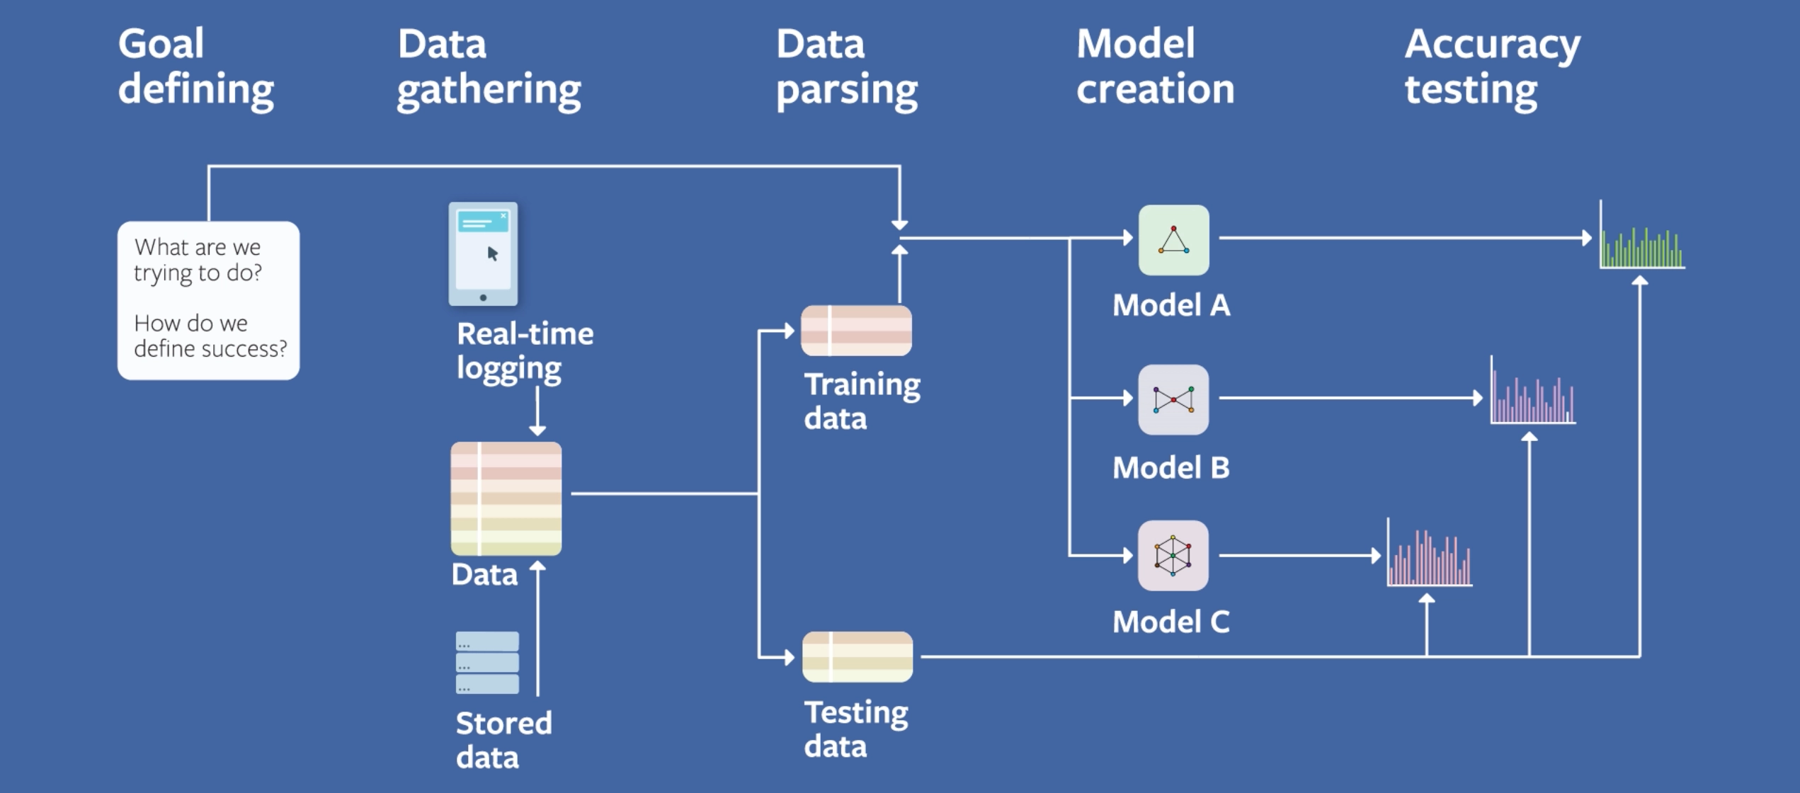

Slide 7
MACHINE LEARNING CLASSIFICATION MODELS
1. Ensemble with Cross Validation
2. SVM
3. Naive Bayes
4. Decision Tree
5. Decision Tree Bagging
6. Extra Tree Classifier
7. RandomForest
8. XGBOOST
9. ADABOOST
10. CATBOOST
11. ANN
12. Deep Learning

Slide 8
 | PRECISION | RECALL | F1-SCORE | SUPPORT | ACCURACY
SVM | 1.00 | 0.99 | 0.99 | 75 | 99.1228%
NAIVE BAYES | 0.59 | 0.66 | 0.62 | 67 | 90.3509%
DECISION TREE | 0.59 | 0.66 | 0.62 | 67 | 92.9825%
DT BAGGING | 0.59 | 0.66 | 0.62 | 67 | 92.9825%
EXTRA TREE | 0.59 | 0.66 | 0.62 | 67 | 92.9825%
RANDOM FOREST | 0.59 | 0.66 | 0.62 | 67 | 97.3684%
GRADIENT DESCENT | 0.59 | 0.66 | 0.62 | 67 | 97.3684%
XGBOOST | 0.97 | 0.99 | 0.98 | 75 | 97.3684%
ADABOOST | 0.97 | 1.00 | 0.99 | 75 | 98.2456%
ANN | 0.96 | 1.00 | 0.98 | 75 | 97.3684%
DEEP LEARNING | 0.96 | 1.00 | 0.98 | 75 | 97.3684%
CLASSFICIATION REPORT

Slide 9
VISUALIZATION
Analyzing the relationship between the features using
1. Confusion Matrix
2. Bar Graph
3. Pie Chart

Slide 10
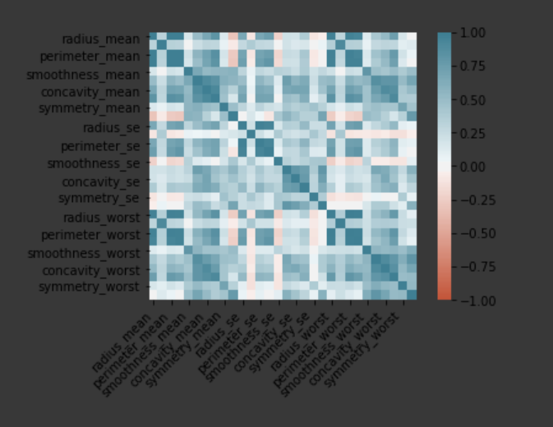
CONFUSION MATRIX

Slide 11
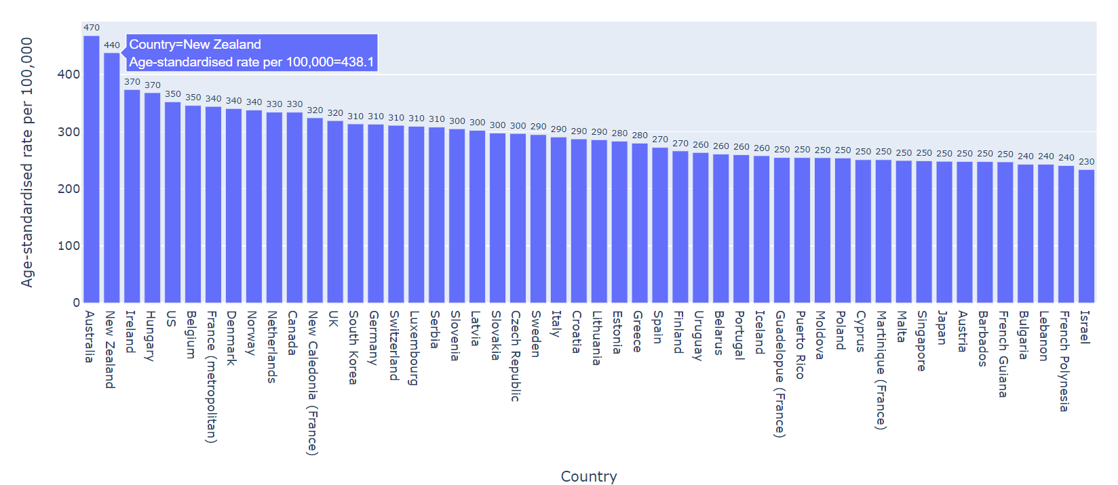
BAR GRAPH

Slide 12
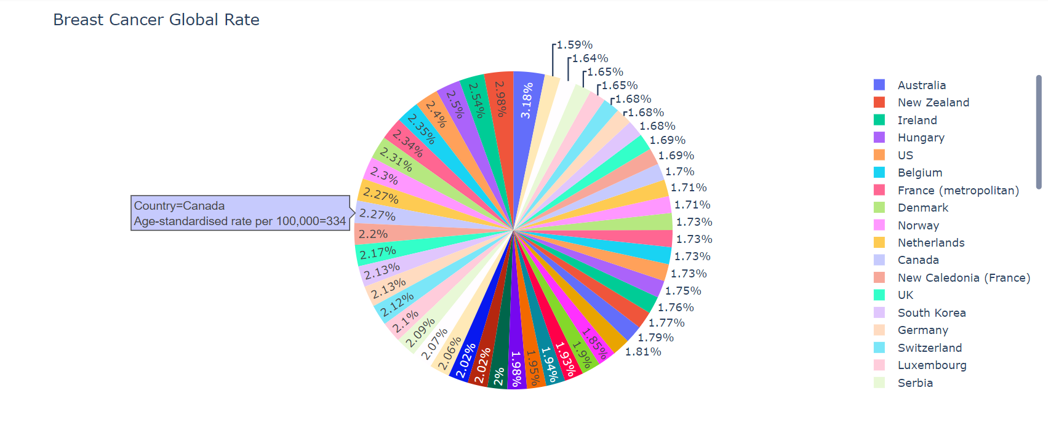
PIE CHART

Slide 13
EVALUATION METRICS
Evaluating a model is a core part of building an effective machine learning model. Different evaluation metrics are used for different kinds of problems

Slide 14
EVALUATION METRICS
TYPES
When we talk about predictive models, we are talking either about a regression model (continuous output) or a classification model (nominal or binary output). The evaluation metrics used in each of these models are different.
CLASS OUTPUT
PROBABILITY OUTPUT
Algorithms like SVM and KNN create a class output. For instance, in a binary classification problem, the outputs will be either 0 or 1. However, today we have algorithms which can convert these class outputs to probability. But these algorithms are not well accepted by the statistics community.
Algorithms like Logistic Regression, Random Forest, Gradient Boosting, Adaboost etc. give probability outputs. Converting probability outputs to class output is just a matter of creating a threshold probability.

Slide 15
EVALUATION METRICS
LOSS FUNCTIONS
MEAN ABSOLUTE ERROR:
MEAN SQUARED ERROR:
Measure of errors between paired observations expressing the same phenomenon.
J(Q) = 1 . Σ abs(h(x_{i}) - y_{i})
n
{ n: data size
h(x): hypothesis functi on
J(Q): Q0 + Q1x1 + . . . . . + Qnxn
y: predicted output }
Defined as the sum of square of residuals.
J(Q) = 1 . Σ (h(x_{i}) - y_{i})²
n
{ n: data size
h(x): hypothesis functi on
J(Q): Q0 + Q1x1 + . . . . . + Qnxn
y: predicted output }

Slide 16
EVALUATION METRICS
LOSS FUNCTIONS
ROOT MEAN SQUARE ERROR:
RELATIVE ABSOLUTE ERROR:
Relative Absolute Error (RAE) is a way to measure the performance of a predictive model and is expressed as a ratio, comparing a mean error (residual) to errors
J(Q) = Σ (h(x_{i}) - y_{i})
Σ (h(x_{i}) - y_{mean})
Root Mean Square Error (RMSE) is the standard deviation of the residuals (prediction errors)
J(Q) = ( 1 . Σ (h(x_{i}) - y_{i})²)^{1/2}
n
{ n: data size
h(x): hypothesis functi on
J(Q): Q0 + Q1x1 + . . . . . + Qnxn
y: predicted output }

Slide 17
EVALUATION METRICS
LOSS FUNCTIONS
RELATIVE SQUARED ERROR:
R-SQUARED ERROR:
It takes the total squared error and normalizes it by dividing by the total squared error of the simple predictor.
J(Q) = Σ (h(x_{i}) - y_{i})²
Σ (h(x_{i}) - y_{mean})²
{ n: data size
h(x): hypothesis function
J(Q): Q0 + Q1x1 + . . . + Qnxn
y: predicted output }
It is the proportion of the variance in the dependent variable that is predictable from the independent variable.
R² = 1 - RSE = 1 - J(Q) = Σ (h(x_{i}) - y_{i})²
Σ (h(x_{i}) - y_{mean})²
{ n: data size
h(x): hypothesis function
J(Q): Q0 + Q1x1 + . . . + Qnxn
y: predicted output }

Slide 18
EVALUATION METRICS
CROSS VALIDATION
k-Fold (k=3)
Cross Validation is a validation technique for the model to statistically examine the generalization pattern of the results on the independent dataset
A better approach where dataset is bifurgated into three, the training data, the validation data and the test data.
k-Fold (k)
In this method, the data is grouped into k folds and model is trained into k-1 times. Each time k-1 portion is trained and is validated over the remaining portion.
k-Fold (k=2)
It means the data is grouped into two i.e. the training and the test data.

Slide 19
EVALUATION METRICS
INFORMATION GAIN
When we use a node in a decision tree to partition the training instances into smaller subsets the entropy changes. Information gain is a measure of this change in entropy.
Gain(T,X):
Entropy(T)-Entropy(T, X)
ENTROPY
Entropy is the measure of uncertainty of a random variable, it characterizes the impurity of an arbitrary collection of examples. The higher the entropy more the information content.
Entropy: - Σp_{i*}log(p_{i})
GINI INDEX
Gini Index is a metric to measure how often a randomly chosen element would be incorrectly identified.
GiniIndex: 1 - Σ(p_{i})²

Slide 20
EVALUTATION METRICS
CROSS ENTROPY
Cross Entropy is said to be the total entropy b/w two probability distribution. Moreover, it builds upon the idea of entropy from Information Theory and calculates the no.of bites required to be transmitted an averge event from one distribution to another.
H(P, Q) = -sum x * P(x) * log(Q(x))
{ x: random variable x in X discrete state
P(x): probability of event x in target distribution P
P(Q): probability of event x in Q }

Slide 21
CONFUSION MATRIX
A confusion matrix is a table that is often used to describe the performance of a classification model (or “classifier”) on a set of test data for which the true values are known. It allows the visualization of the performance of an algorithm.
A confusion matrix is an N X N matrix, where N is the number of classes being predicted. For the problem in hand, we have N=2, and hence we get a 2 X 2 matrix.

Slide 22
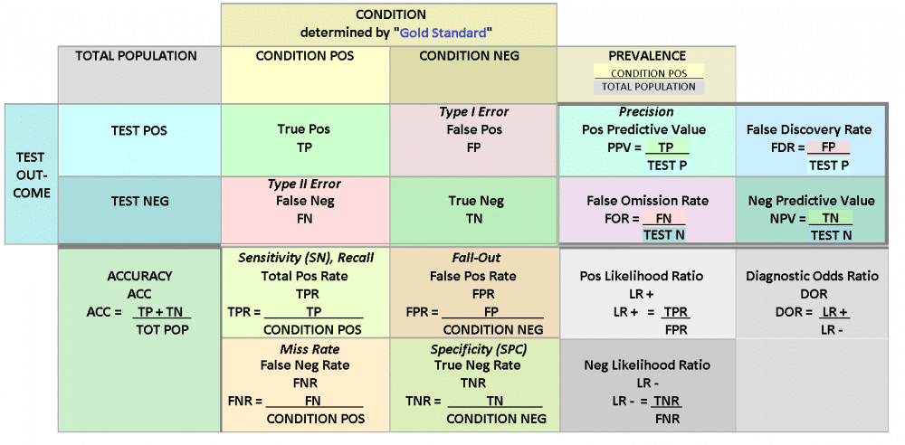

Slide 23
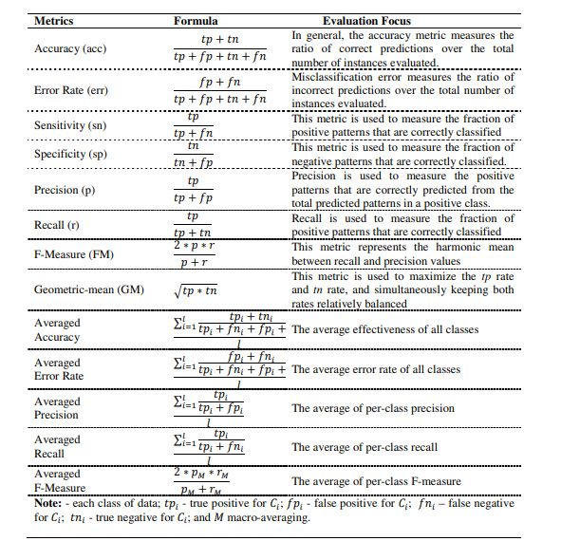

Slide 24


EVALUATION MATRICS
F1-SCORE
In statistical analysis of binary classification, the F1 score (also F-score or F-measure) is a measure of a test's accuracy. The traditional F-measure or balanced F-score (F1 score) is the harmonic mean of precision and recall:
F1: 2/ (recall⁻¹ + precision⁻¹)
F1: 2*(recall.precision)
(recall + precsion)

Slide 25
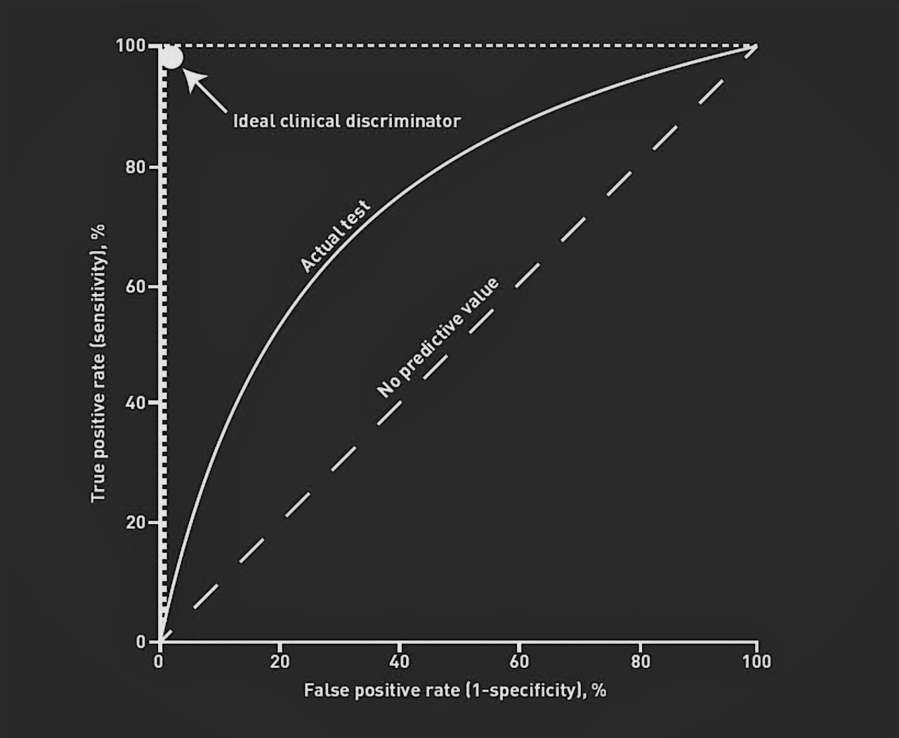
EVALUATION MATRICS
ROC CURVE
A useful tool when predicting the probability of a binary outcome is the Receiver Operating Characteristic curve, or ROC curve.
It is a plot of the false positive rate (x-axis) versus the true positive rate (y-axis) for a number of different candidate threshold values between 0.0 and 1.0.
The true positive rate is calculated as the number of true positives divided by the sum of the number of true positives and the number of false negatives. It describes how good the model is at predicting the positive class when the actual outcome is positive.

Slide 26
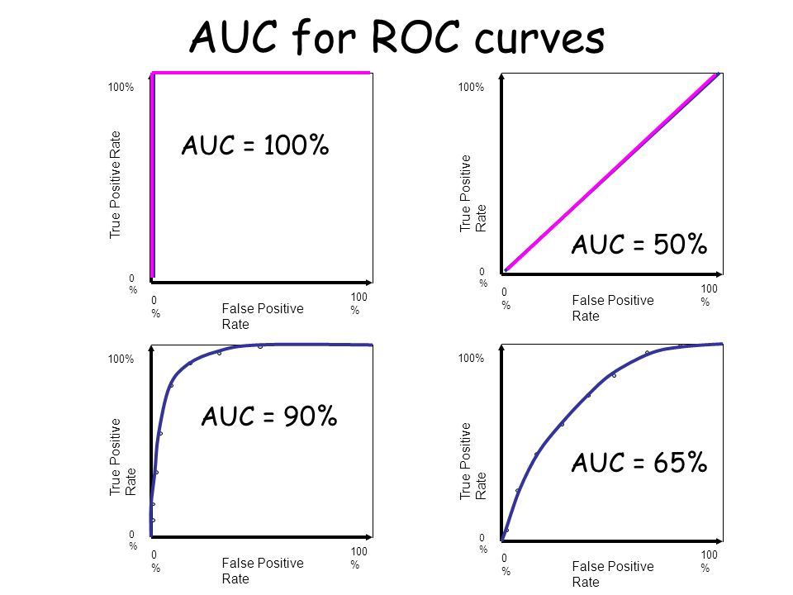
EVALUATION MATRICS
ROC CURVE FORMULAS
True Positive Rate = True Positives / (True Positives + False Negatives)
Sensitivity = True Positives / (True Positives + False Negatives)
False Positive Rate = False Positives / (False Positives + True Negatives)
False Positive Rate = False Positives / (False Positives + True Negatives)
False Positive Rate = 1 - Specificity

Slide 27
CONCLUSION
As we’ve seen, the ROC curve isn’t just a single number; it’s a whole curve. It provides nuanced details about the behavior of the classifier, but it’s also hard to quickly compare many ROC curves to each other. The AUC is one way to summarize the ROC curve into a single number so that it can be compared easily and automatically. A good ROC curve has a lot of space under it (because the true positive rate shoots up to 100% very quickly). A bad ROC curve covers very little area. So high AUC is good, and low AUC is not so good.

Slide 28
Thank You For YOUR TIME
CAPSTONE

